Slide 1
Historic Facts Generator: AI- Powered Narratives for Tourism

Slide 2

Historic Facts Generator: AI-Powered Narratives for Tourism
Transforming historical data into engaging stories
By Team: Tech T-Rex
Team Lead: Wagmare Sanjana
Team Members:
Rangdal Pavansai
Alladi Amay Raj Yadav

Slide 3
Table of content: AI-Powered Narrative Generation for Tourism
1
Problem Statement
2
Why Solve This Problem?
3
Prototype Overview
Manual narrative creation, lack of engaging content, and scalability challenges.
Boosting tourism, scalability, accessibility, and the role of AI.
Generates historical places, narratives, facts, and traffic information.
4
AI-Powered Narrative Generation
5
AI Technologies Used
6
Future Modifications
Google Gemini API, Wikimedia Commons API, Streamlit, and Python.
Recommendation system, speech synthesis, localization, user feedback, and integration with tourism services.
Generates compelling narratives using the Gemini API.
7
Future Enhancements: Integration with Tourism Services Integration with Tourism Services
8
User Feedback and Localization
9
Conclusion
User feedback for improvements and multilingual support.
Scalable, engaging solution for tourism with a global vision.
Tour booking, hotel reservations, and transportation services.

Slide 4

Problem Statement
Build an AI-powered system that converts historical facts into compelling narratives for local tourism websites and apps.
Challenge 1
Challenge 2
Challenge 3
Manual narrative creation is time-consuming.
Lack of engaging content for tourists.
Difficulty in scaling content creation for multiple locations.

Slide 5

Why Solve This Problem?
Tourism Impact
Scalability
Engaging narratives attract more tourists, boosting local economies.
AI can generate content for thousands of historical places effortlessly.
Accessibility
Makes historical information more engaging and accessible to a wider audience.

Slide 6
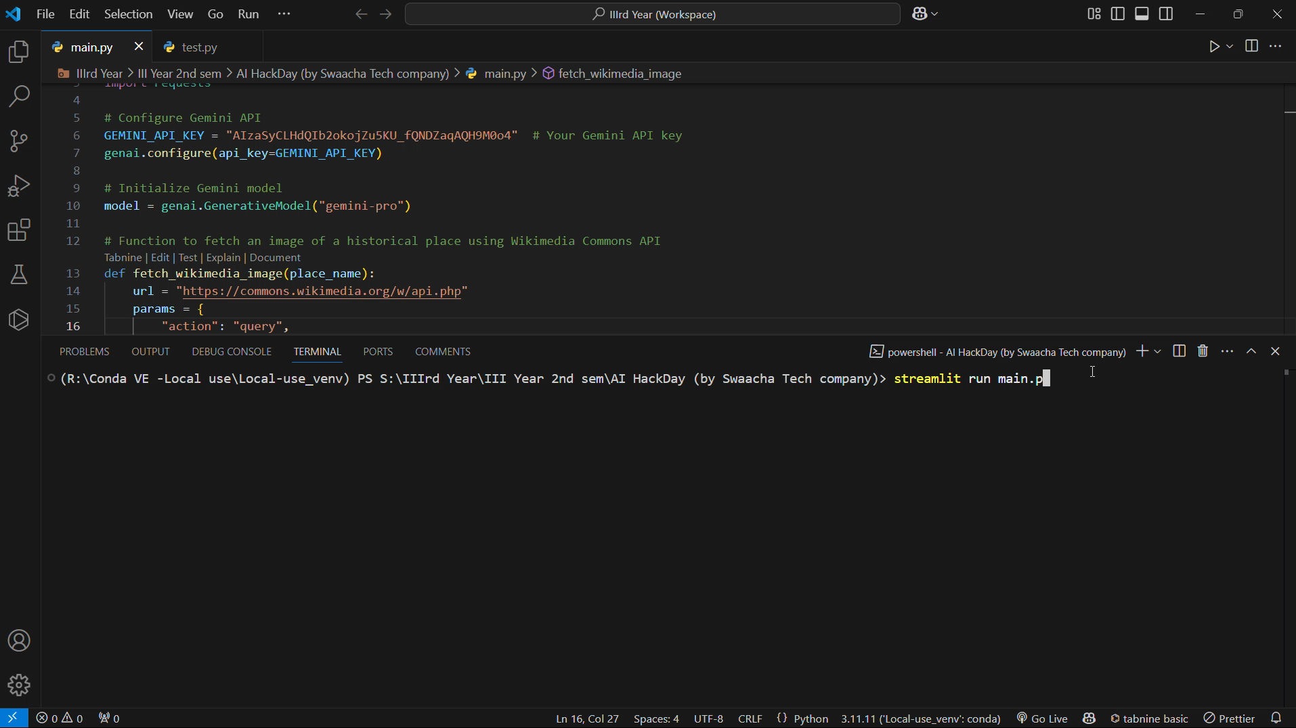
Prototype Overview
Features
Generates historical places, narratives, facts, and traffic information.
Workflow
User selects a state in India, AI generates content, and displays results.

Slide 7




AI-Powered Narrative Generation
Prompt
Example Prompt: "Write a compelling narrative about the historical significance of \[Place Name\] in \[State\], India, in 100 words."
Gemini API
Processes prompts and generates narratives, facts, and traffic info.
Benefits
Saves time and resources, ensures consistent quality and engagement, adaptable to different tones and styles.

Slide 8





AI Technologies Used
Google Gemini API
Wikimedia Commons API
Generates narratives, facts, and traffic information.
Fetches relevant images for historical places.
Streamlit
Python
Provides the user interface for the prototype.
Backend logic for API integration and data processing.

Slide 9
Future Enhancements
Recommendation System
1
Suggest personalized historical places based on user preferences.
2
Speech Synthesis (Text-to-Speech)
Add multilingual support for audio narratives.
Localization
3
Support multiple languages to make the system globally accessible.
Countries and states
4
Adding more number of countries and states
User Feedback Mechanism
5
Allow users to rate narratives and suggest improvements.
Integration with Tourism Services
6
Enable booking of tours, hotels, and transportation directly from the app.

Slide 10
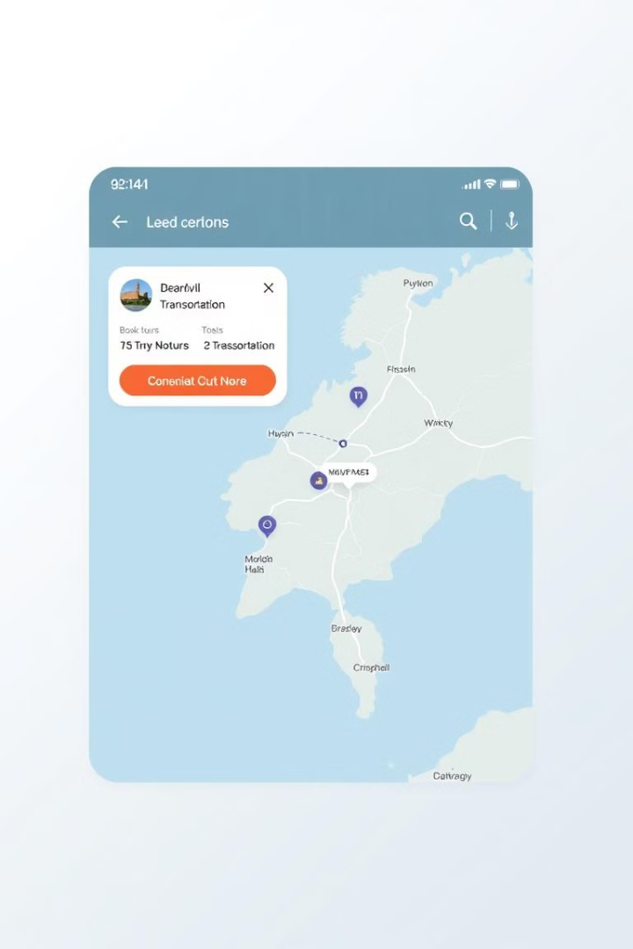
Future Enhancements: Integration with Tourism Services
1
Tour Booking
Direct links to local tour operators.
2
Hotel Reservations
Integration with platforms like Booking.com or MakeMyTrip.
3
Transportation
Real-time traffic updates and cab booking options.

Slide 11



Conclusion
Summary
1
Scalable, engaging solution for tourism leveraging Gemini API and Wikimedia Commons.
Future Vision
2
Expand to global historical sites, add multilingual support, and integrate with tourism services.
Call to Action
3
Let’s revolutionize tourism with AI-powered storytelling!

